Slide 1
FromSoftware
FromSoft’s game design and why its popular

Slide 2

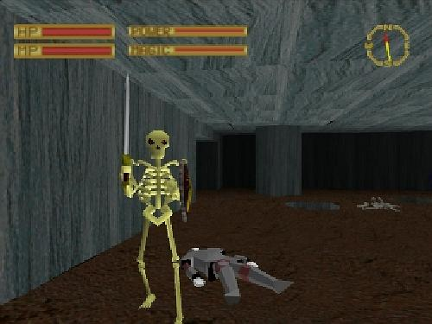
Brief History:
FromSoft is a Japanese game development company
Founded on November 1st, 1986
Were originally a simple office software manufacturer on cartridges until 1994 when cartridge based software had finally lost out to CD’s
They moved to becoming a game development company and has stayed that way ever since

Slide 3
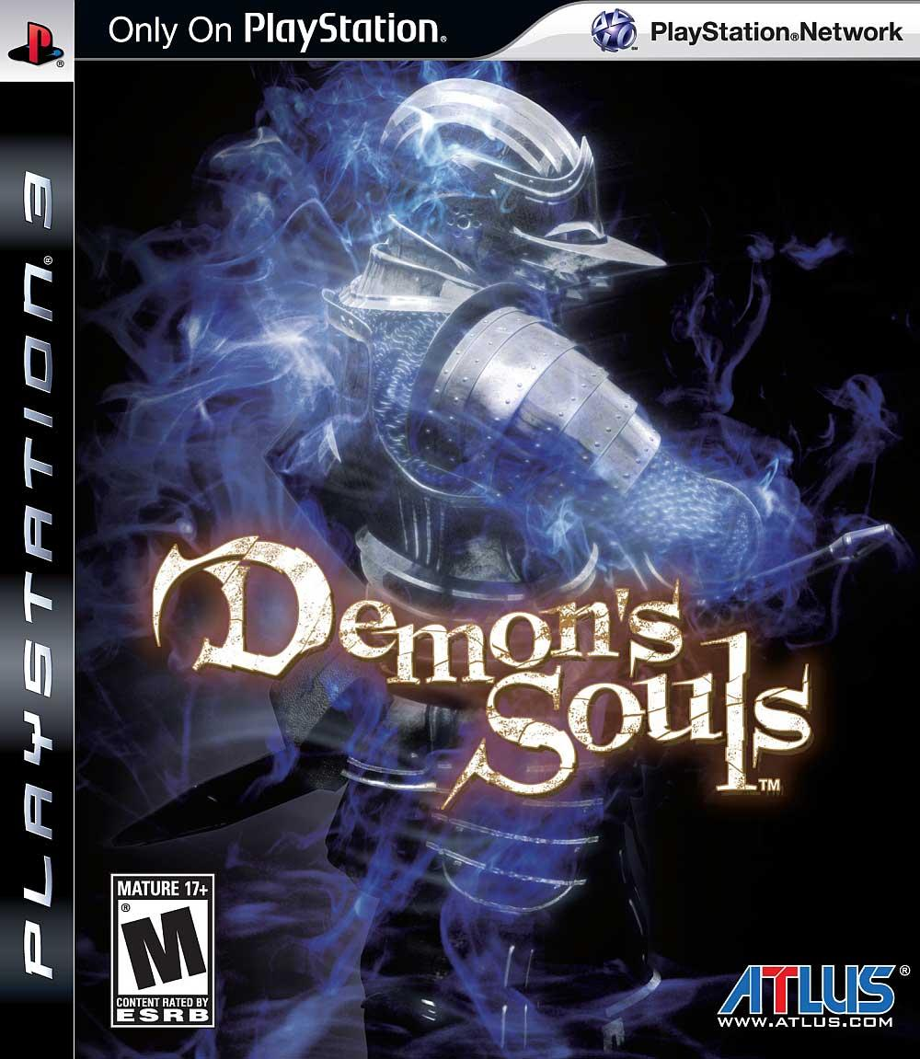
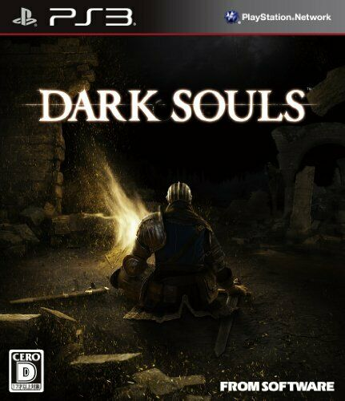
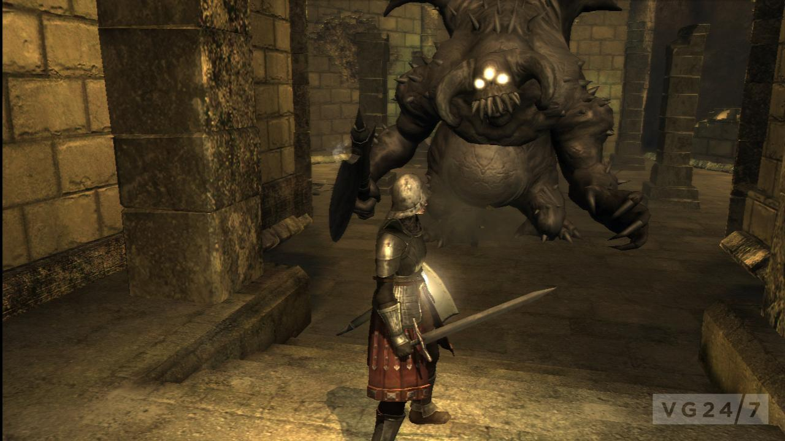
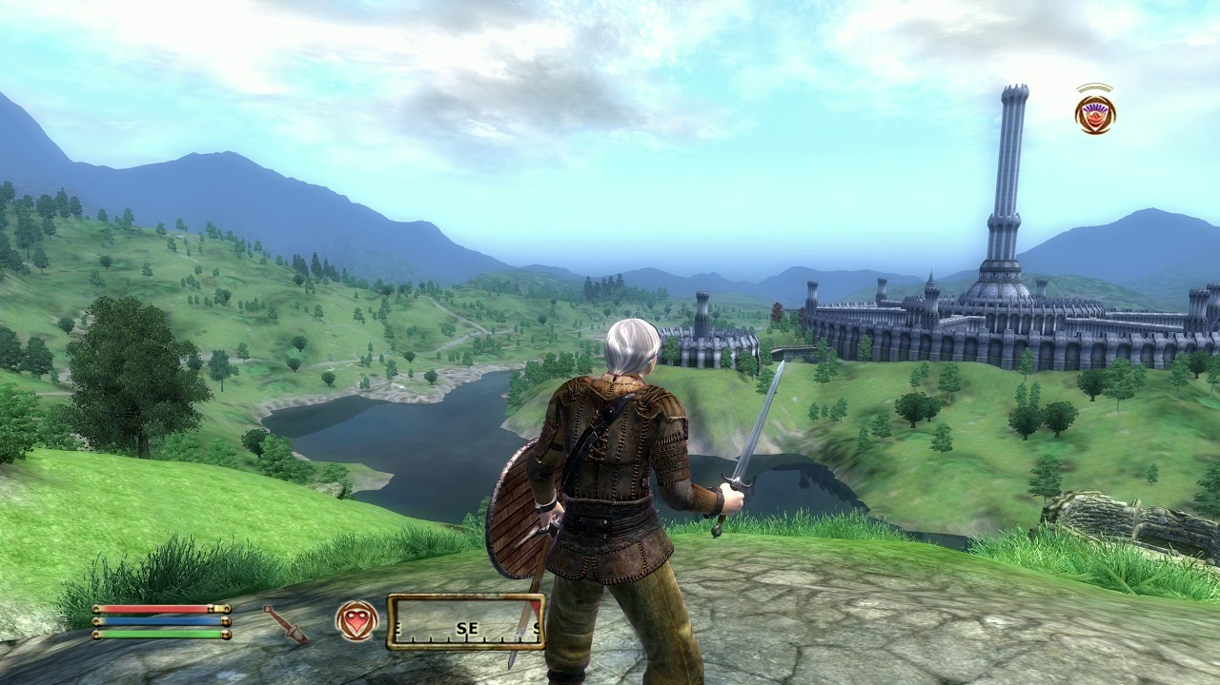
The come up:
FromSoft released a new series of hard cryptic RPG experiences
Demon Souls was released in 2009, but the series took off with Dark Souls was a follow up sequel released in 2011
These games on first glance were nothing special even at the time
But the key lied in the design of these games

Slide 4

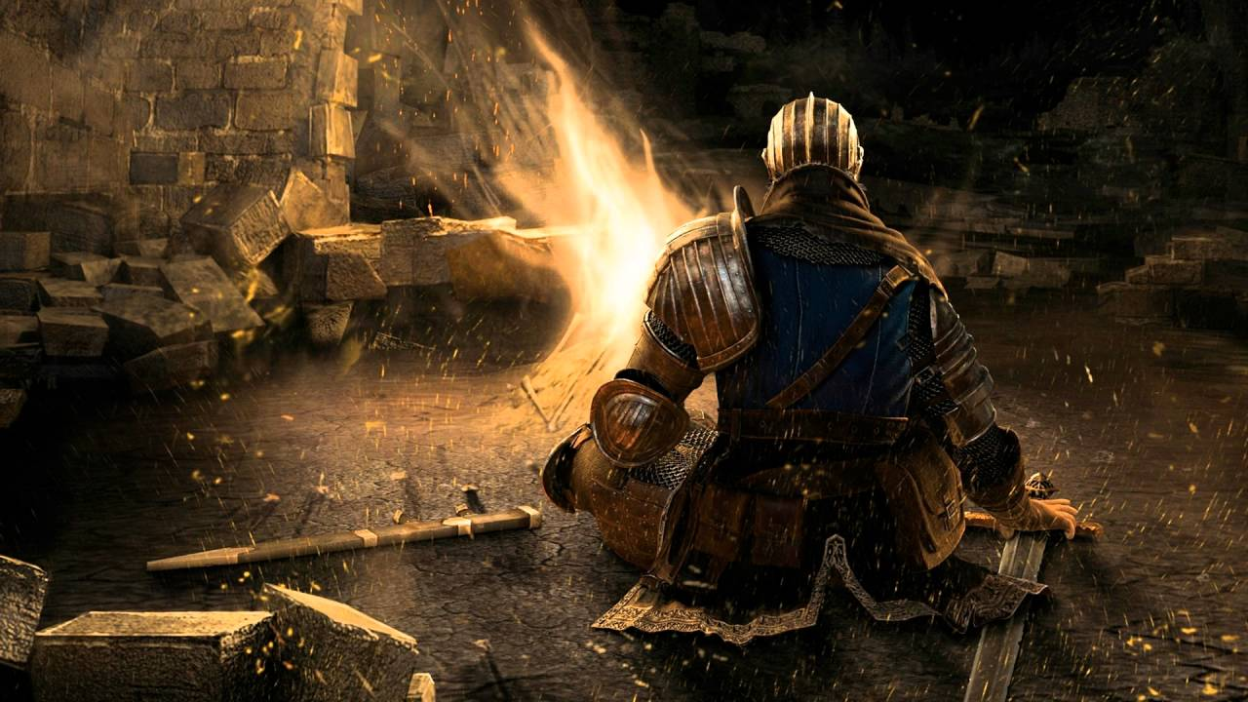
The small stuff:
There is no pause button
No auto saving
No difficulty setting at all
There are no in game guide or tutorial for anything besides controls

Slide 5
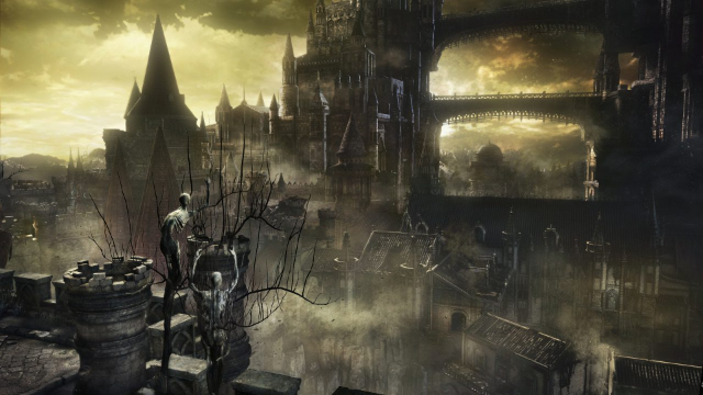
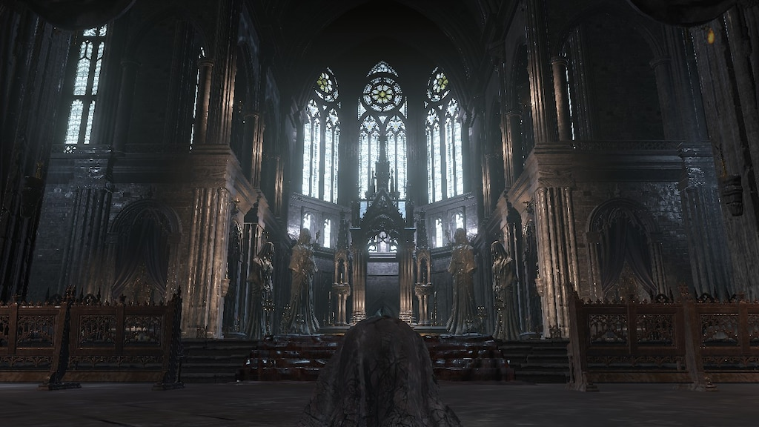
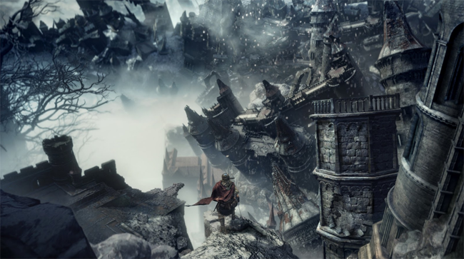
Storytelling:
The games story is usually not told through any kind of cinematics
The set pieces and environments are the story tellers
The world shows you its story, and you put it together

Slide 6
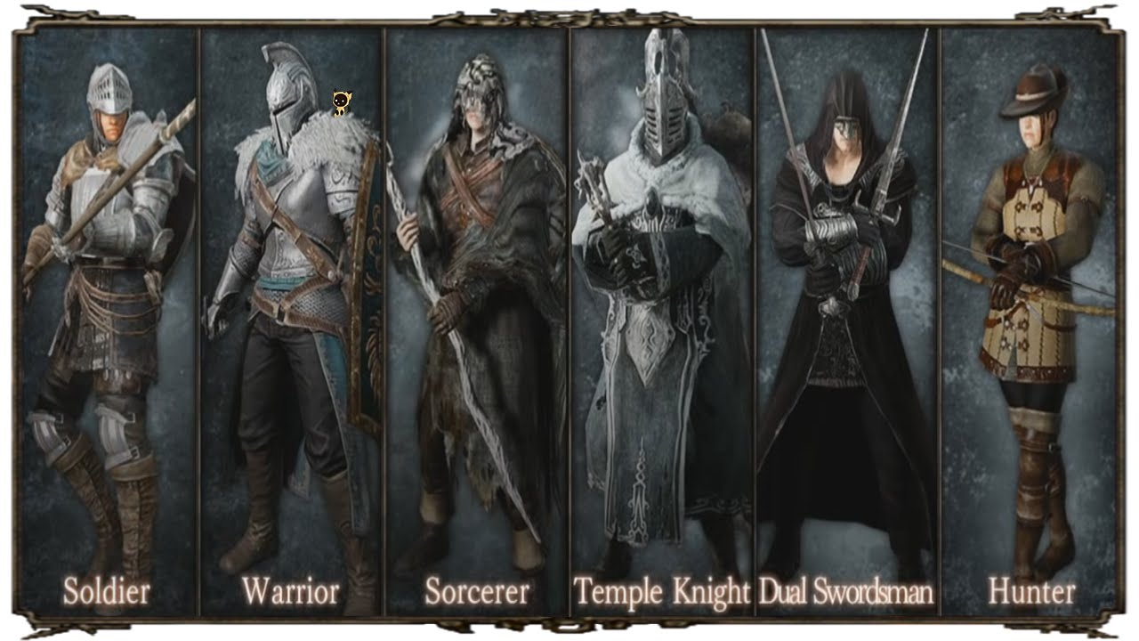
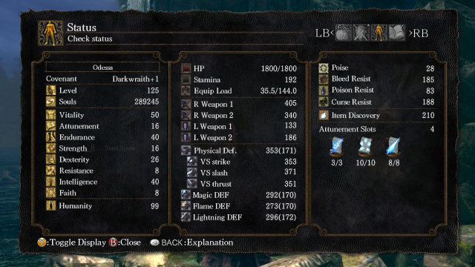
Customization:
Player customization is diverse and completley player dependanet
You can choose from a a multitude of classes that all have varying base stats
You can stay on a classes recommended road path of stats, or make weird mixes of classes
Same goes for weapons and armor

Slide 7
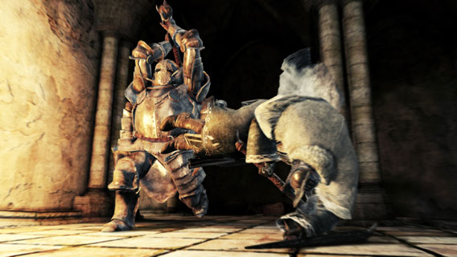
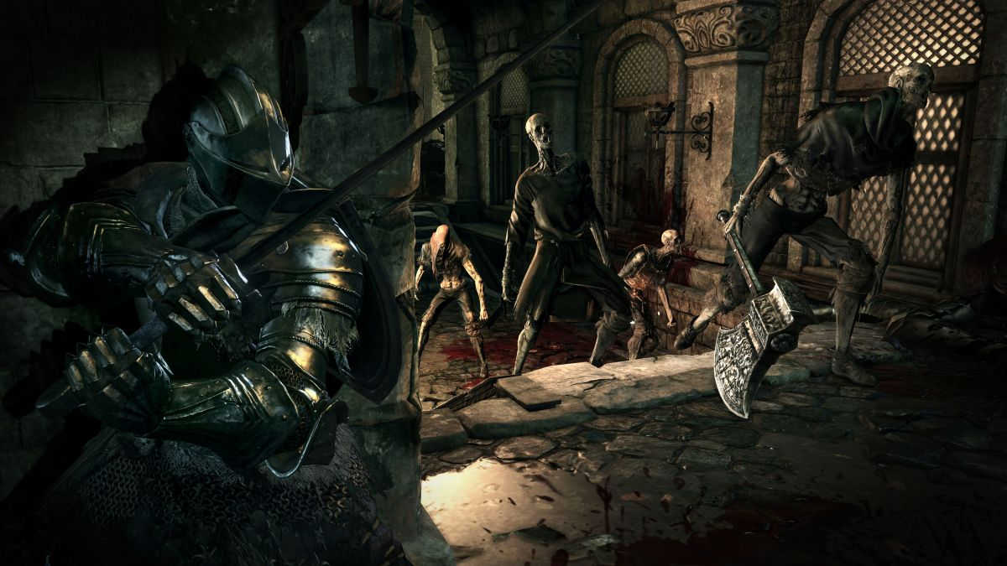
Combat:
Combat is these games is purely based on your ability to multitask
Enemies are designed to be as lethal as possible and will change tactics as soon as you do
There are no breaks in combat unless you make them, you either control the flow of combat or you don’t

Slide 8
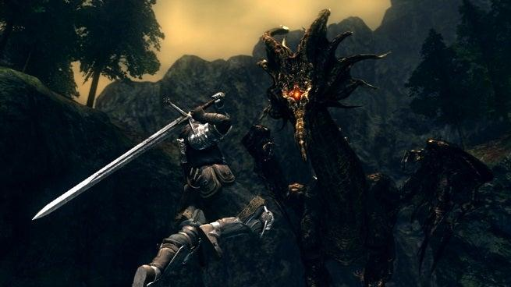
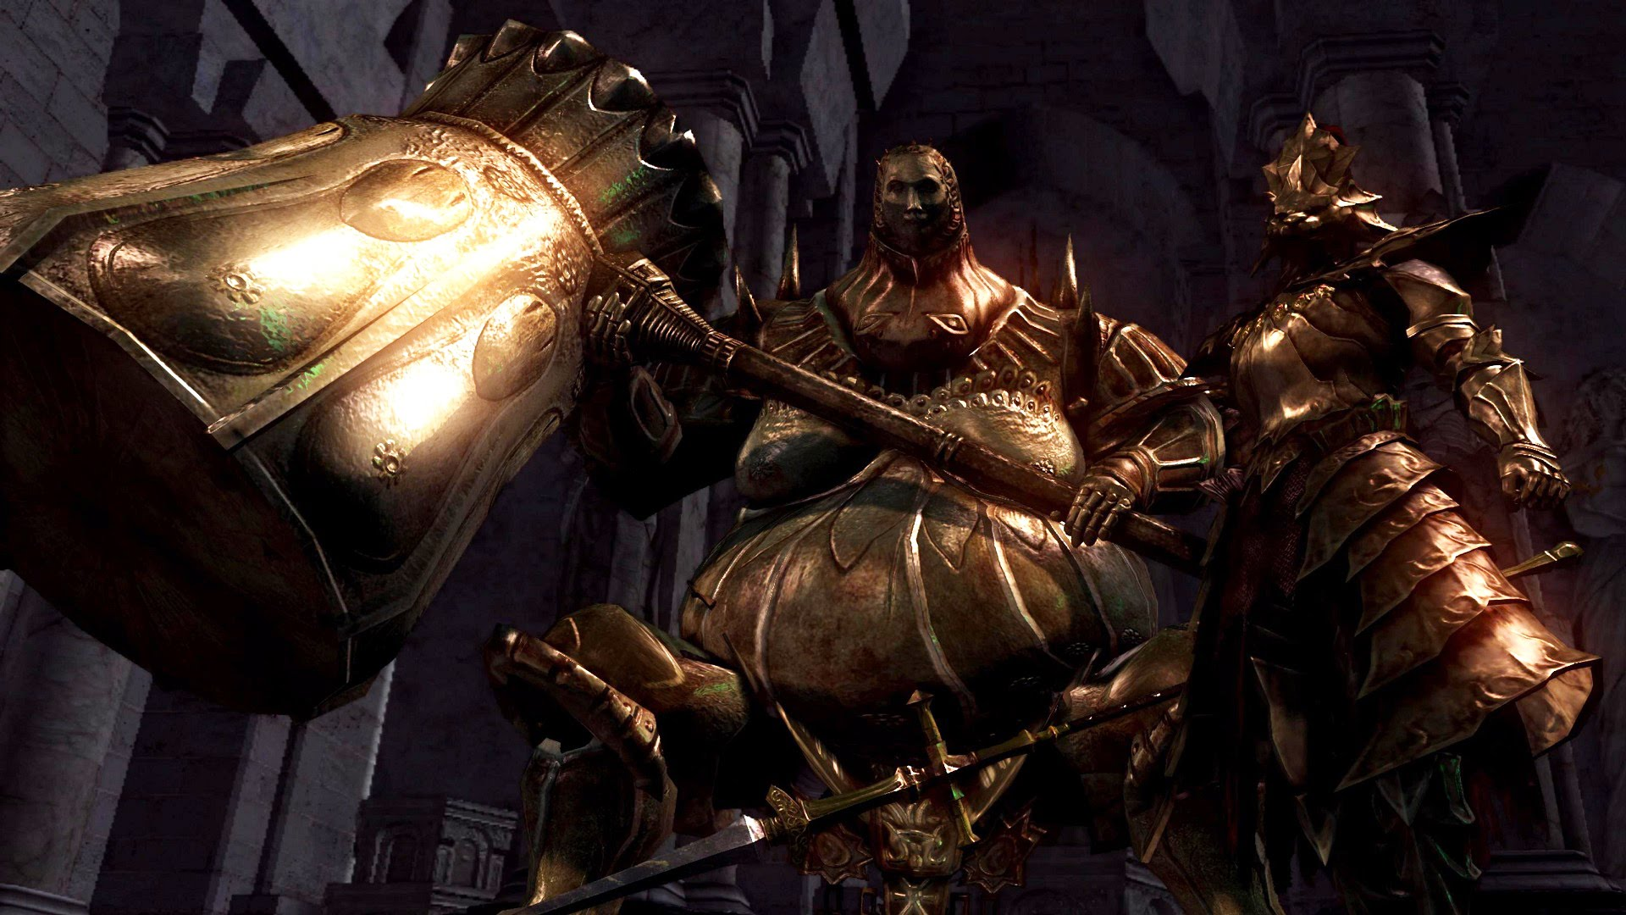
Boss design, the bane of my existence:
Bosses difficulty has a gigantic range
Any mistake is extremely punishing
They’re fast, tough, have varied attacks, and are usually relentless
They control the flow of battle, not you

Slide 9

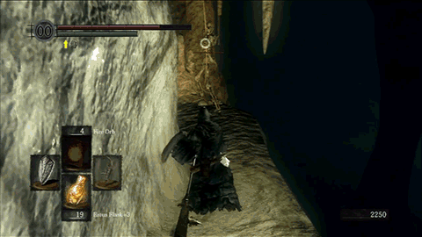
Death:
Dying, it happens alot
When you die, you lose all your souls and respawn at the last rest point
This is where the rage for these games come from
You can get your loot back if you find your body, but it’s risky

Slide 10
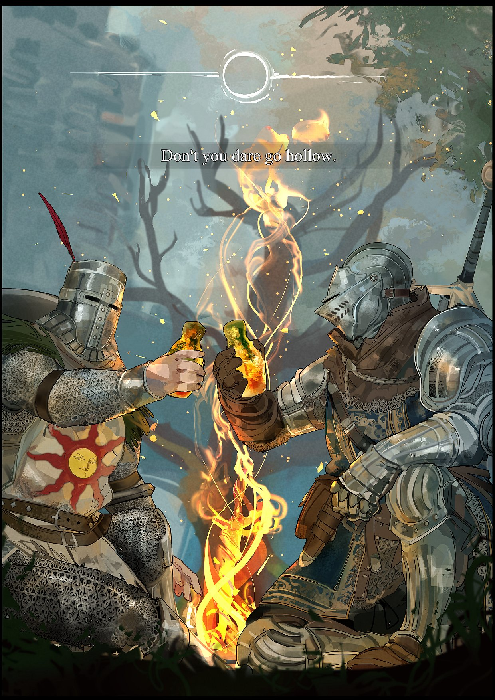
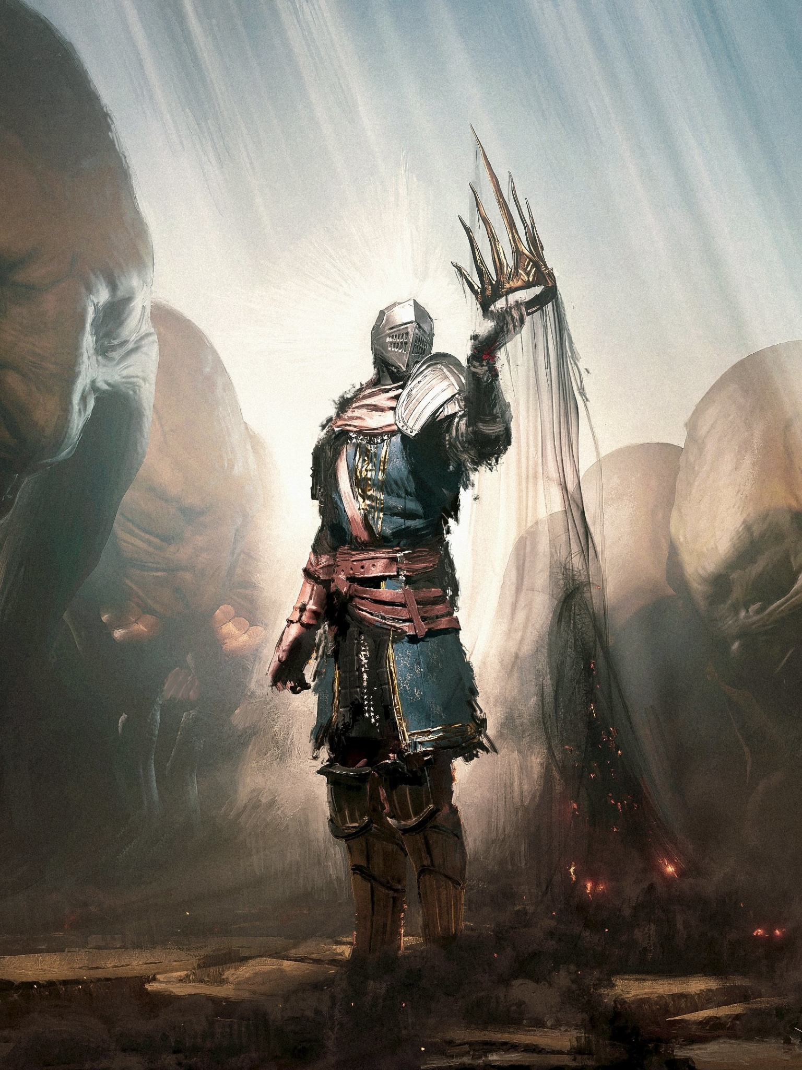
Why people like these games:
The challenge
The seamless story telling
The combat
Progression
Player choice
The world building and enviorments

Slide 11
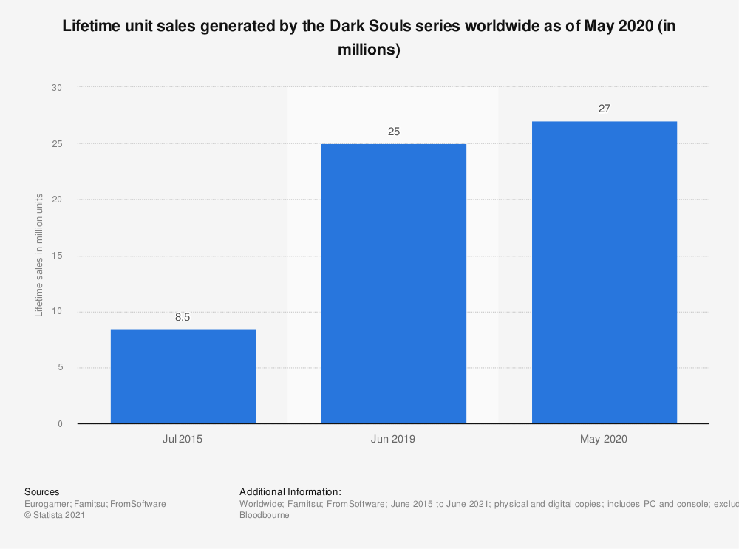
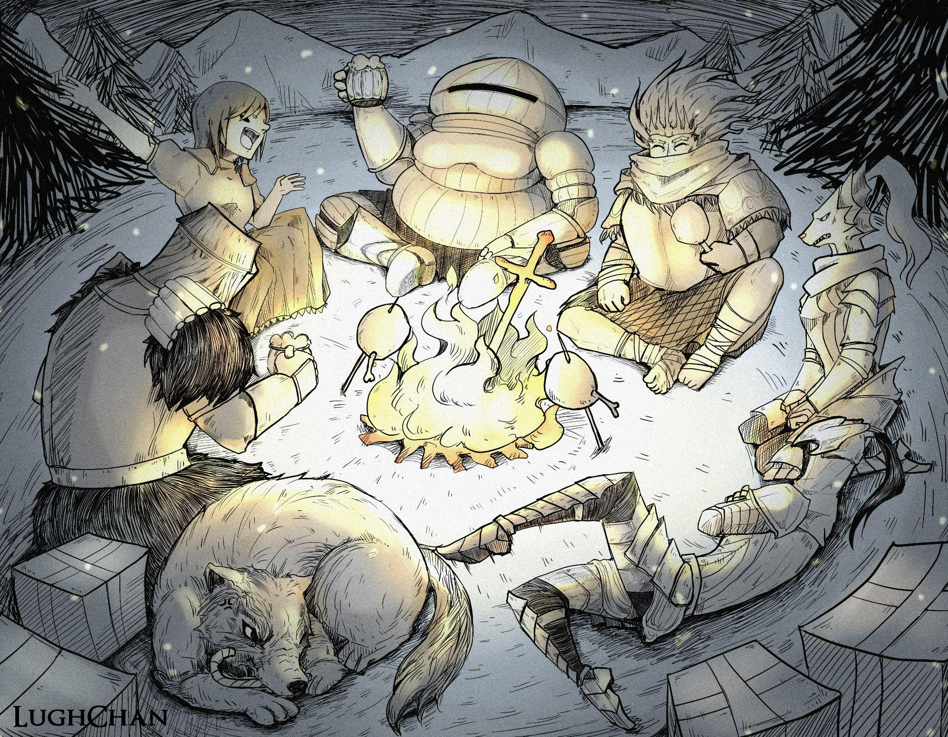
The conclusion:
The games have created a massive fan base
Dark Souls is now a “classic” game
FromSoft has become a titan in the game industry
Games are now constantly compared to the souls series

